Slide 1
Lecture 5 - Gradient Descent
DS 4400: Machine Learning and Data Mining 1

Slide 2
Today
Today
Maximization and Minimization
Gradient Descent
Basic Ideas
In Higher Dimensions In NumPy
Practice
Regression as Gradient Descent
Plotting Using Python

Slide 3
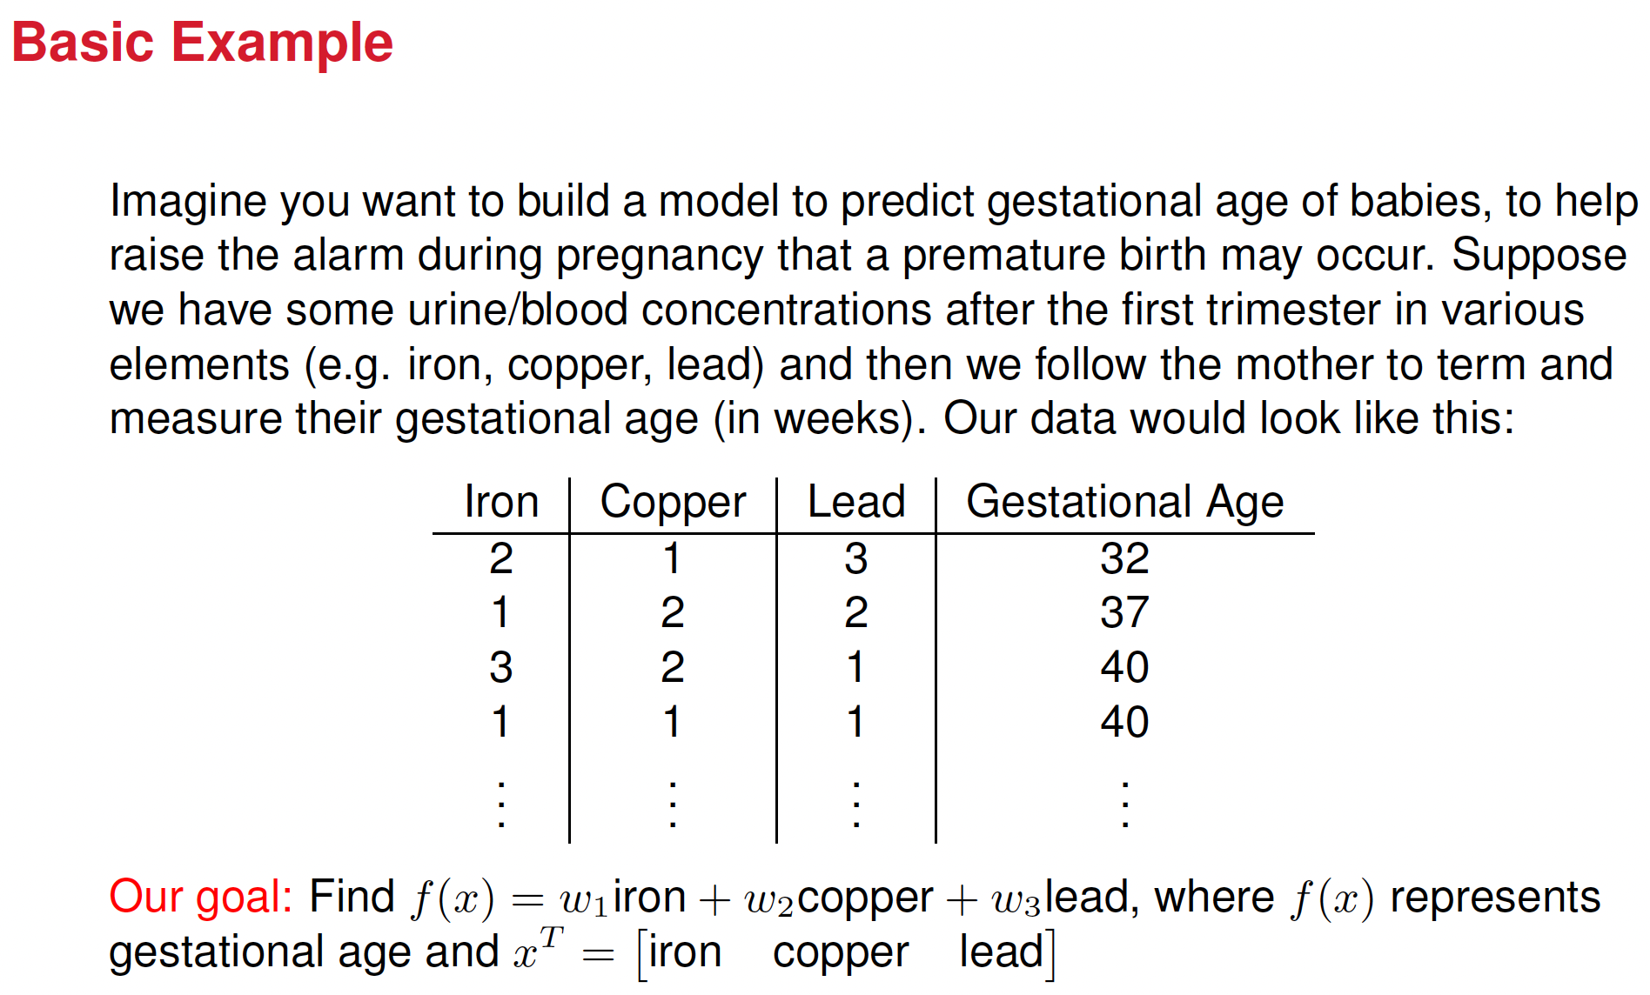

Slide 4
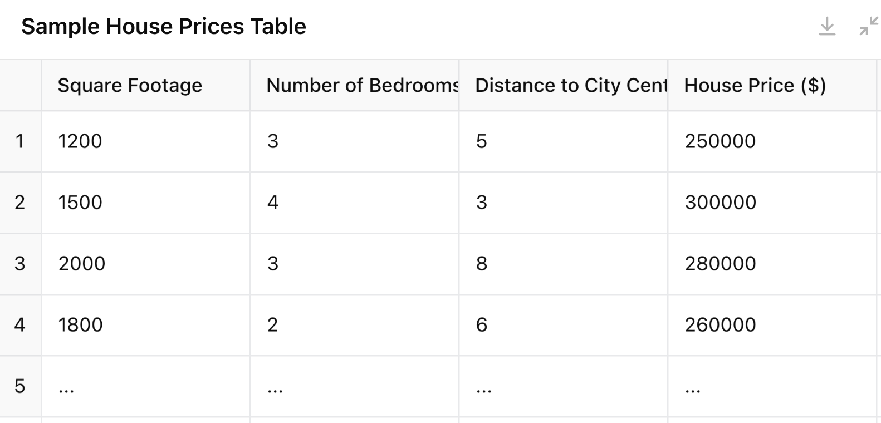














Another example

Slide 5
Previously
We’ve spent a long time discussing how to take derivatives of various functions, including in high dimensions. At a couple points we’ve talked about optimizing using the derivative; that is, finding the derivative with respect to a variable, setting it equal to zero, and solving. This is related to our first topic today.

Slide 6
Maximization and Minimization
The first question we ask today is:
Given a function f (x), what is the x value that will give you the highest or lowest possible output of f (x)?
The mathematical notation to express this query is often written:
max_{x}f (x) or min_{x}f (x)
The majority of machine learning algorithms is about solving this question given some f (x)

Slide 7
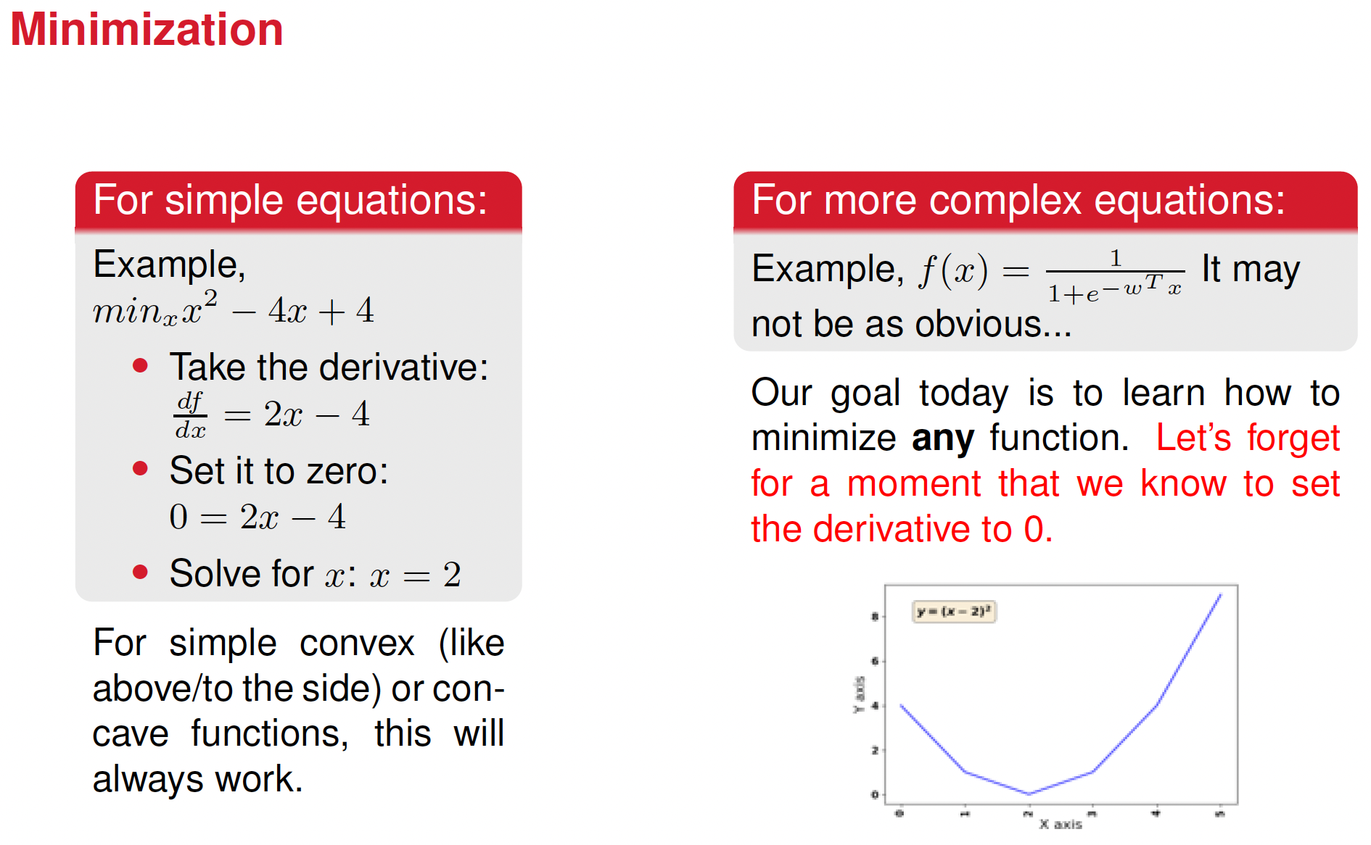



Slide 8
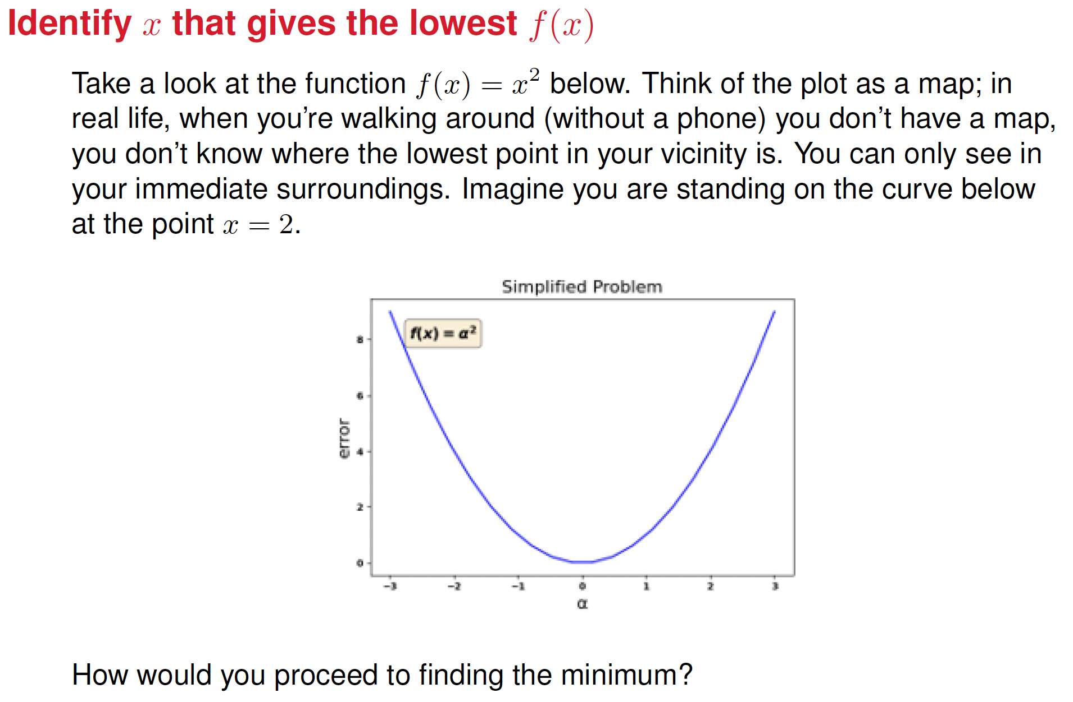

Slide 9
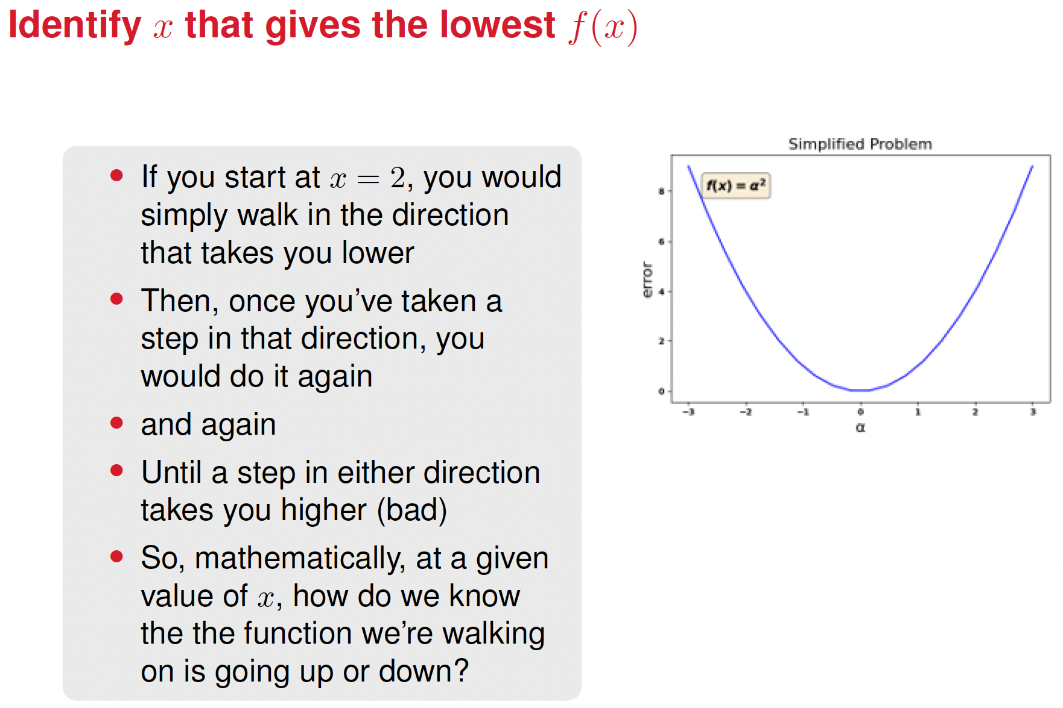
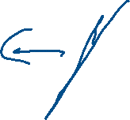


Slide 10
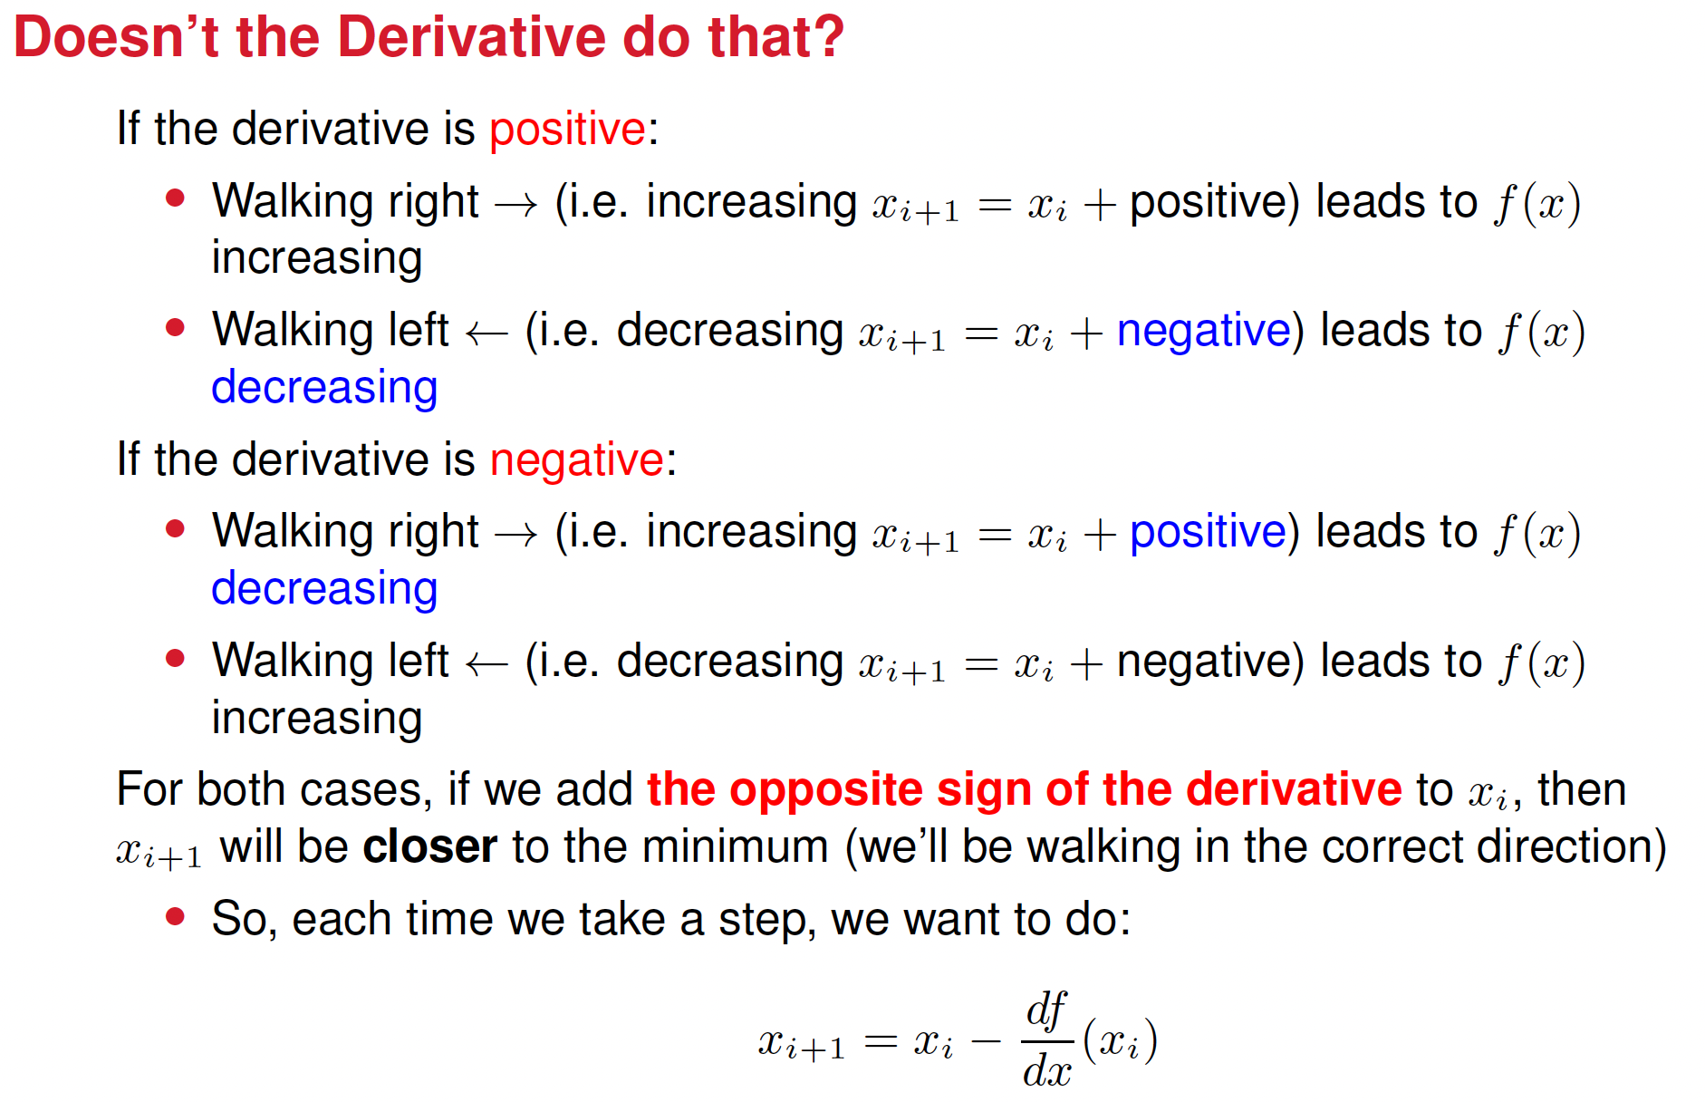


Slide 11
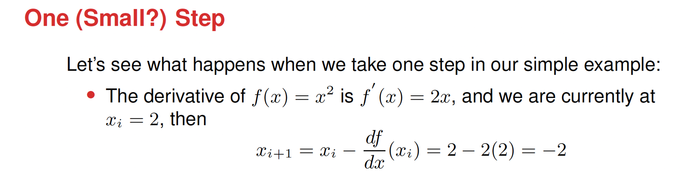






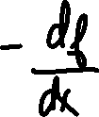










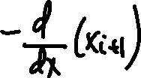


Sometimes, it can get stuck

Slide 12

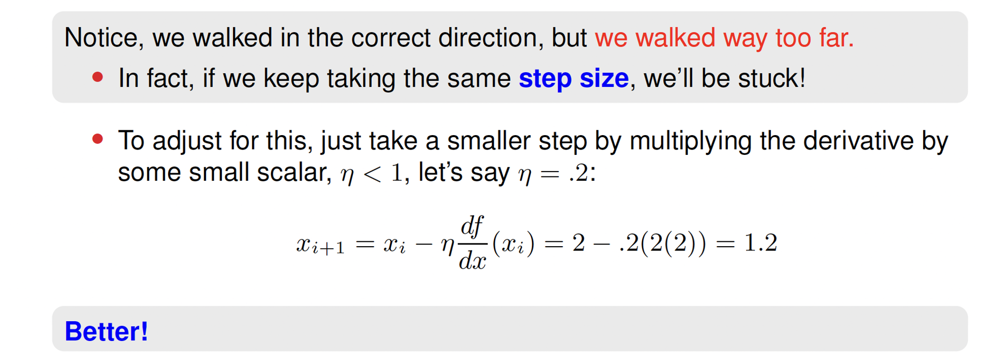






Slide 13
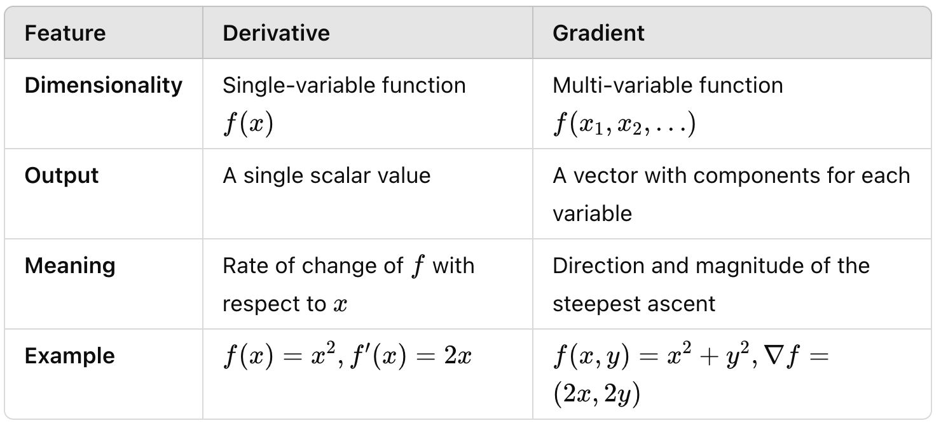
Difference between derivative and gradient

Slide 14
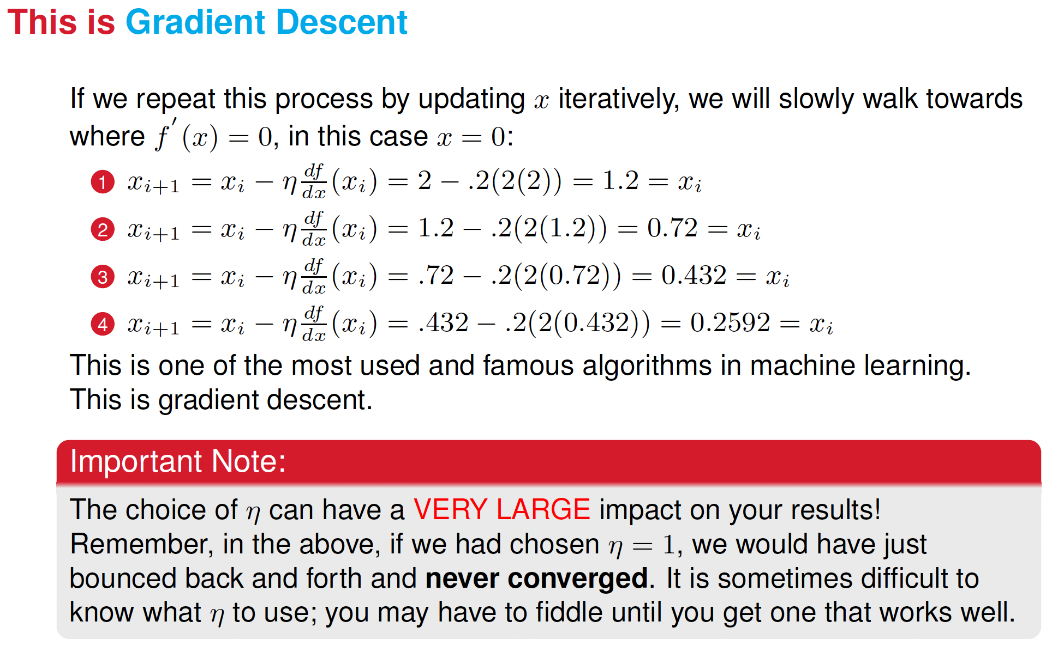

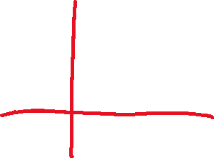
Notice that this is strictly in 1D only for now

Slide 15
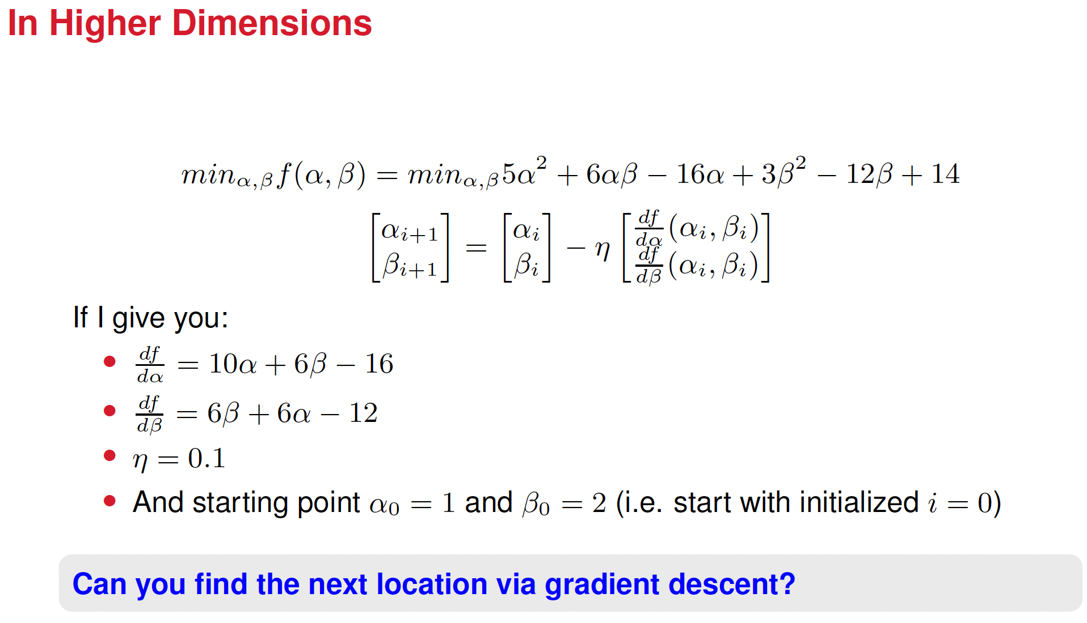
Now it’s in 2D, so here it’s gradient.

Slide 16


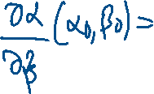









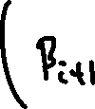

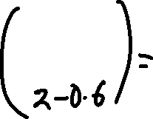












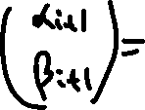









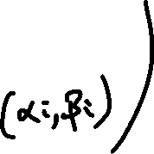
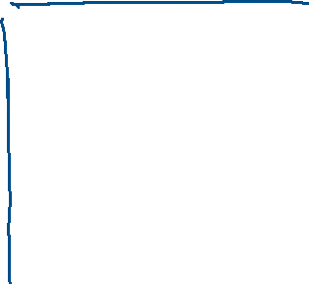







Solution

Slide 17
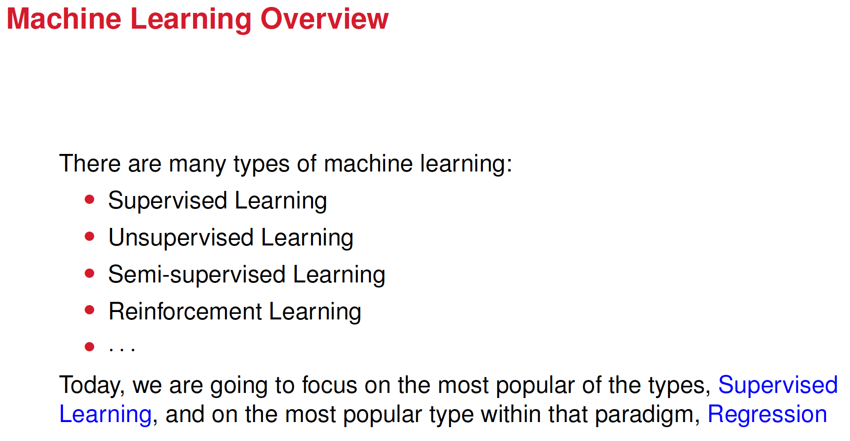

Slide 19
What’s regression and what’s its goal?
The fundamental idea of regression is to find a function that models the relationship between the independent variables (predictors, like Iron, Copper, and Lead) and the dependent variables (output, like Gestational Age) in a way that "fits" the data best.
The goal is to find a function f(X) such that: y ≈ f(X)
Where:
y: The dependent variable (e.g., Gestational Age).
X: The set of independent variables (e.g., Iron, Copper, Lead).
f(X): The regression function that maps X to y.

Slide 20
Linear vs. non-linear regression: what’s the form of the function f(X)
The function f(X) can take different forms:
Linear Regression: Assumes that f(X) is a linear combination of the predictors:
f(X) = w₀​ + w₁​(Iron) + w₂​(Copper) + w₃​(Lead)
That’s, the relationship between predictors and the output is modeled as linear.
Nonlinear Regression: f(X) takes more complex, nonlinear forms, such as:
f(X) = w₀+w₁(Iron)² + w₂log(Copper) + w₃e^{Lead}
In this case, the function captures nonlinear relationships.

Slide 21
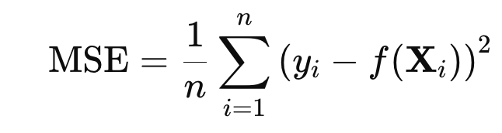
Finding the best-fit function: How do we know which f(X) to choose
The "best-fit" function is typically determined by minimizing a loss function, such as the Mean Squared Error (MSE):
yi​: The actual value of the dependent variable.
f(Xi​): The predicted value by the regression function.
n: Number of observations.
This loss function above minimizes the difference between the observed data and the model's predictions.

Slide 22
Model selection: Which model, i.e. f(X), to use?
Linear models are often used because they are simple, interpretable, and effective in many cases.
Nonlinear models are used when the relationship between variables is complex and cannot be well-approximated by a linear function.
A little bit about terminology:
Basis functions: mathematical tools that transform the input data into a new form, making it easier to model complex, nonlinear relationships. By working in this transformed space, even simple models like linear regression can capture patterns that are otherwise hard to detect.

Slide 23
Regularization and Constraints
To avoid overfitting when using more complex functions, techniques like regularization (e.g., Ridge or Lasso regression) are often applied.
These constrain the complexity of the model to ensure it generalizes well to new data.

Slide 24
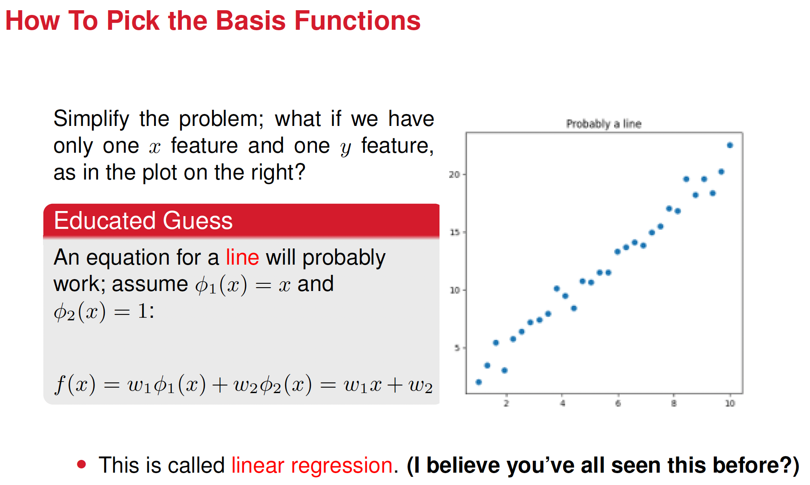

Slide 25
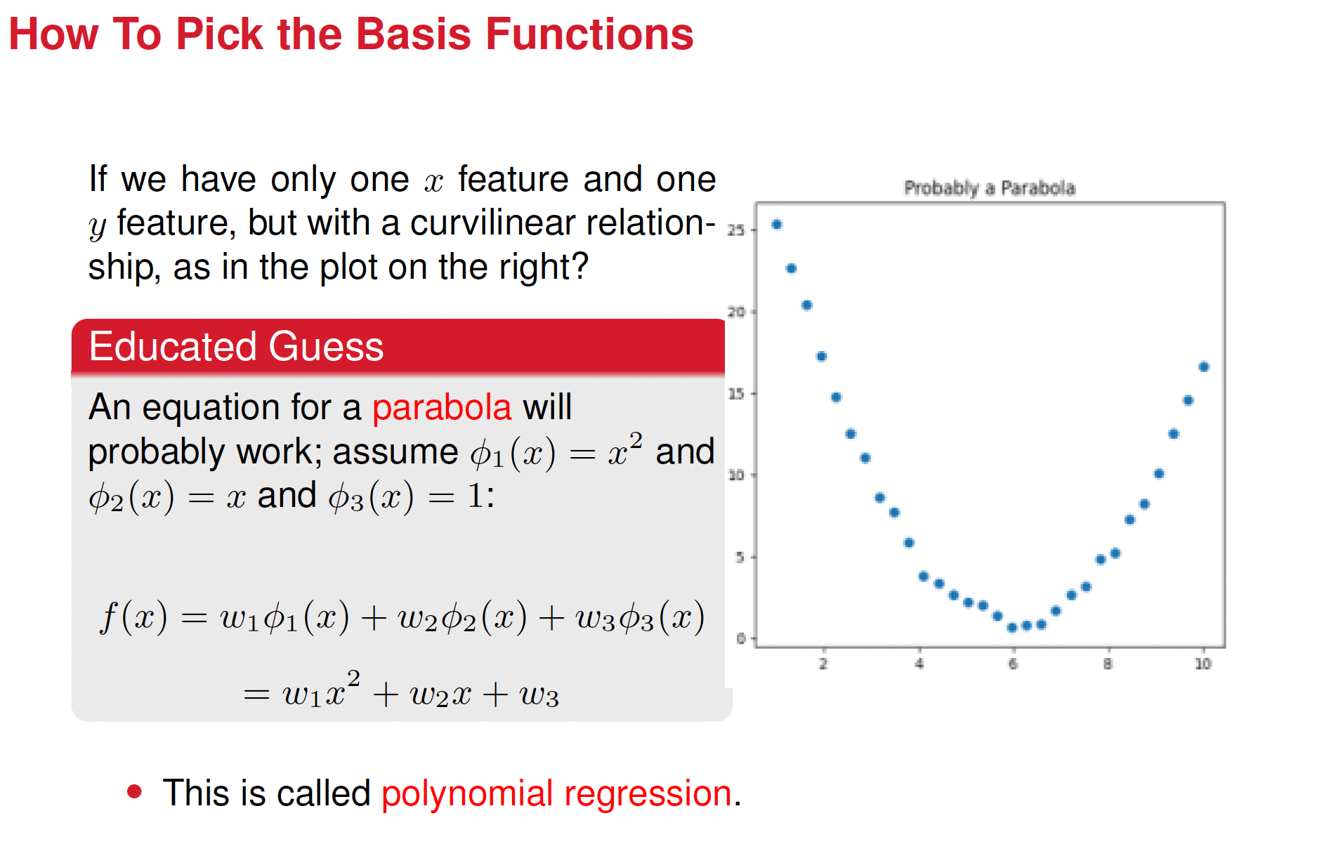

Slide 26
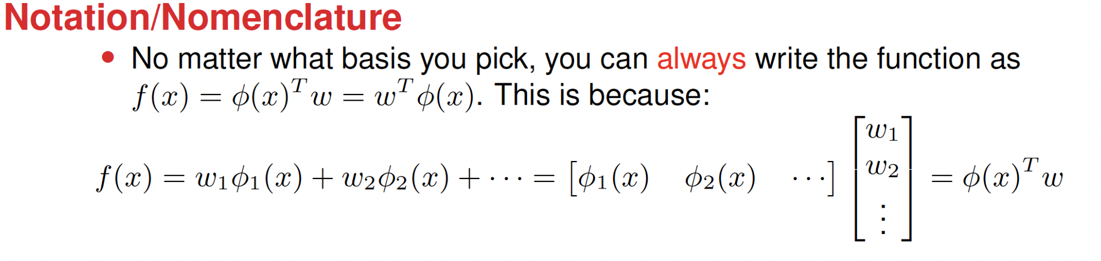
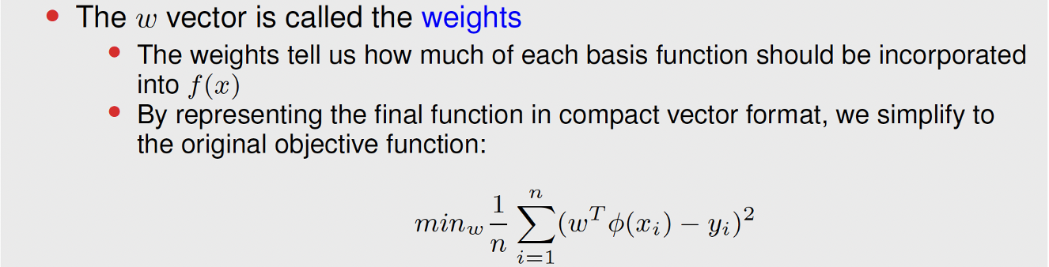



Slide 27
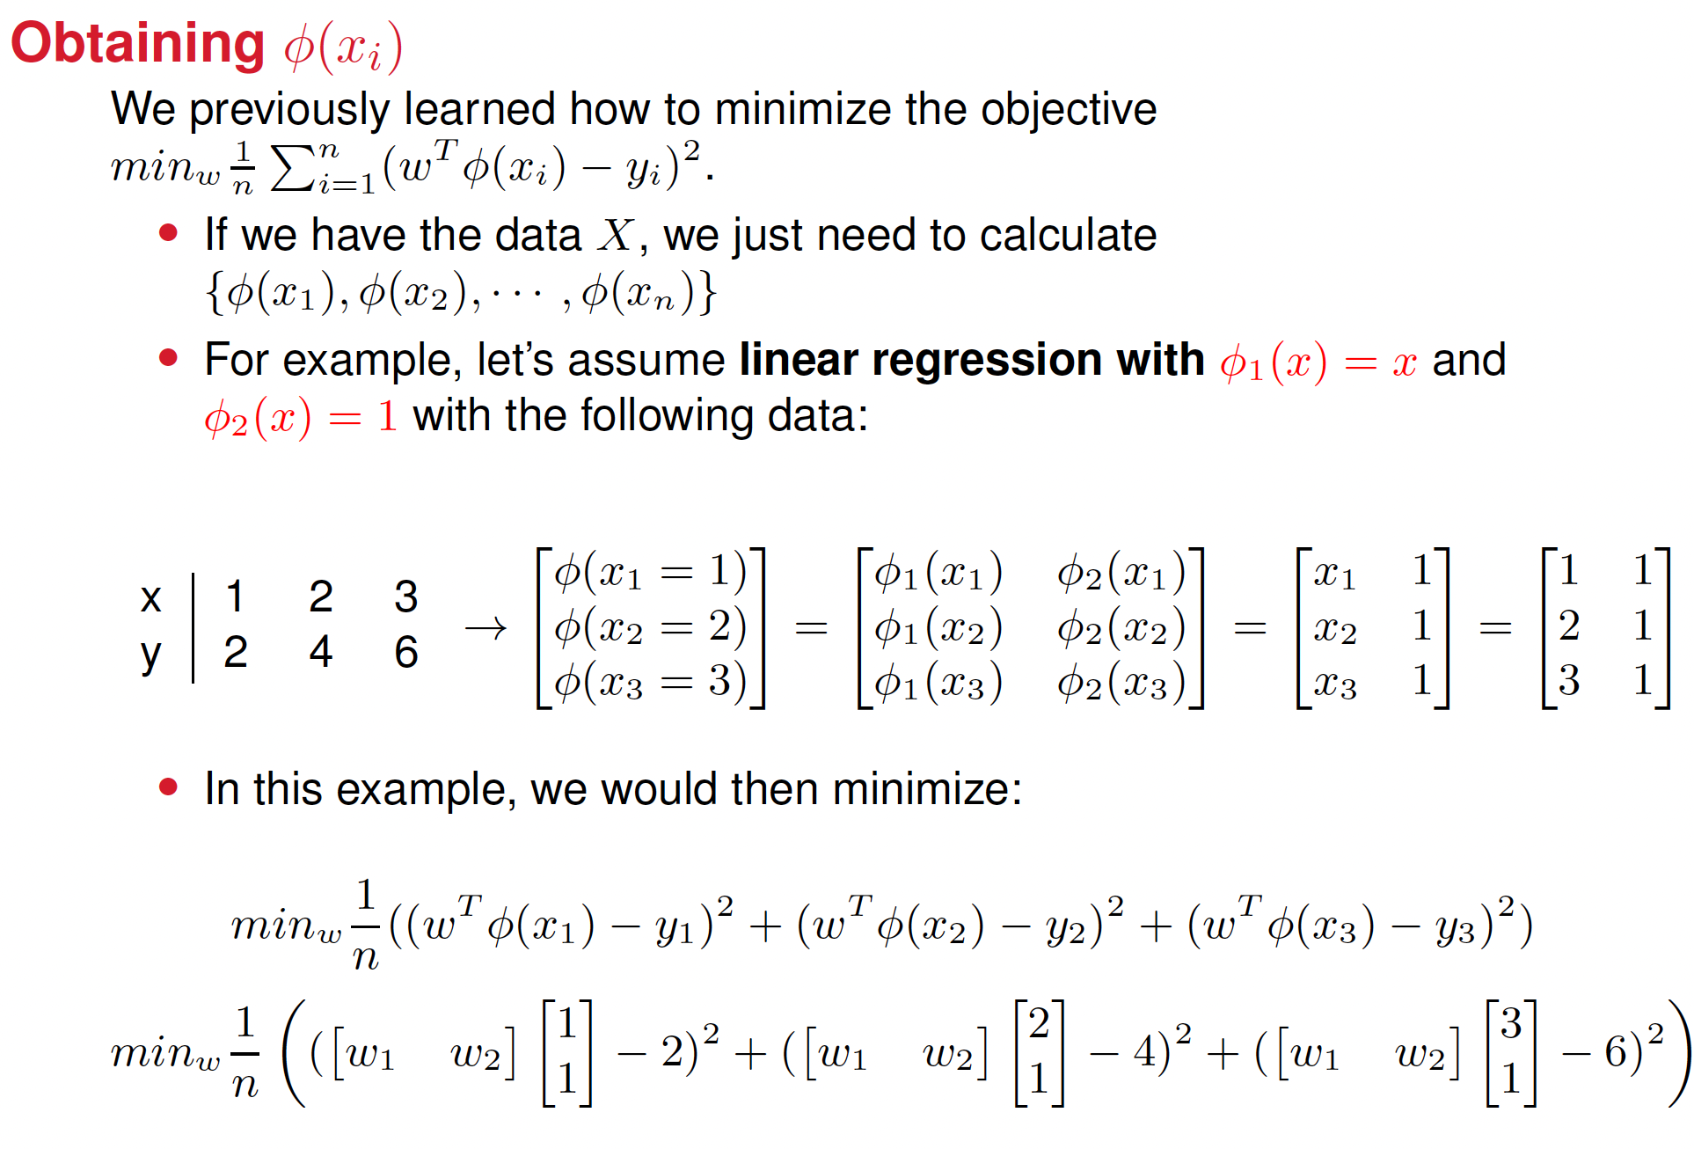





Slide 28

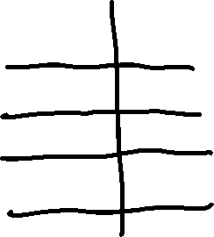






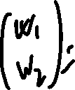












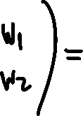

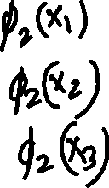












Slide 29




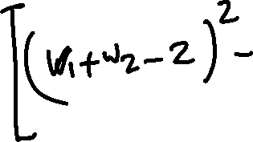






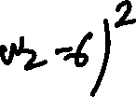

Slide 30
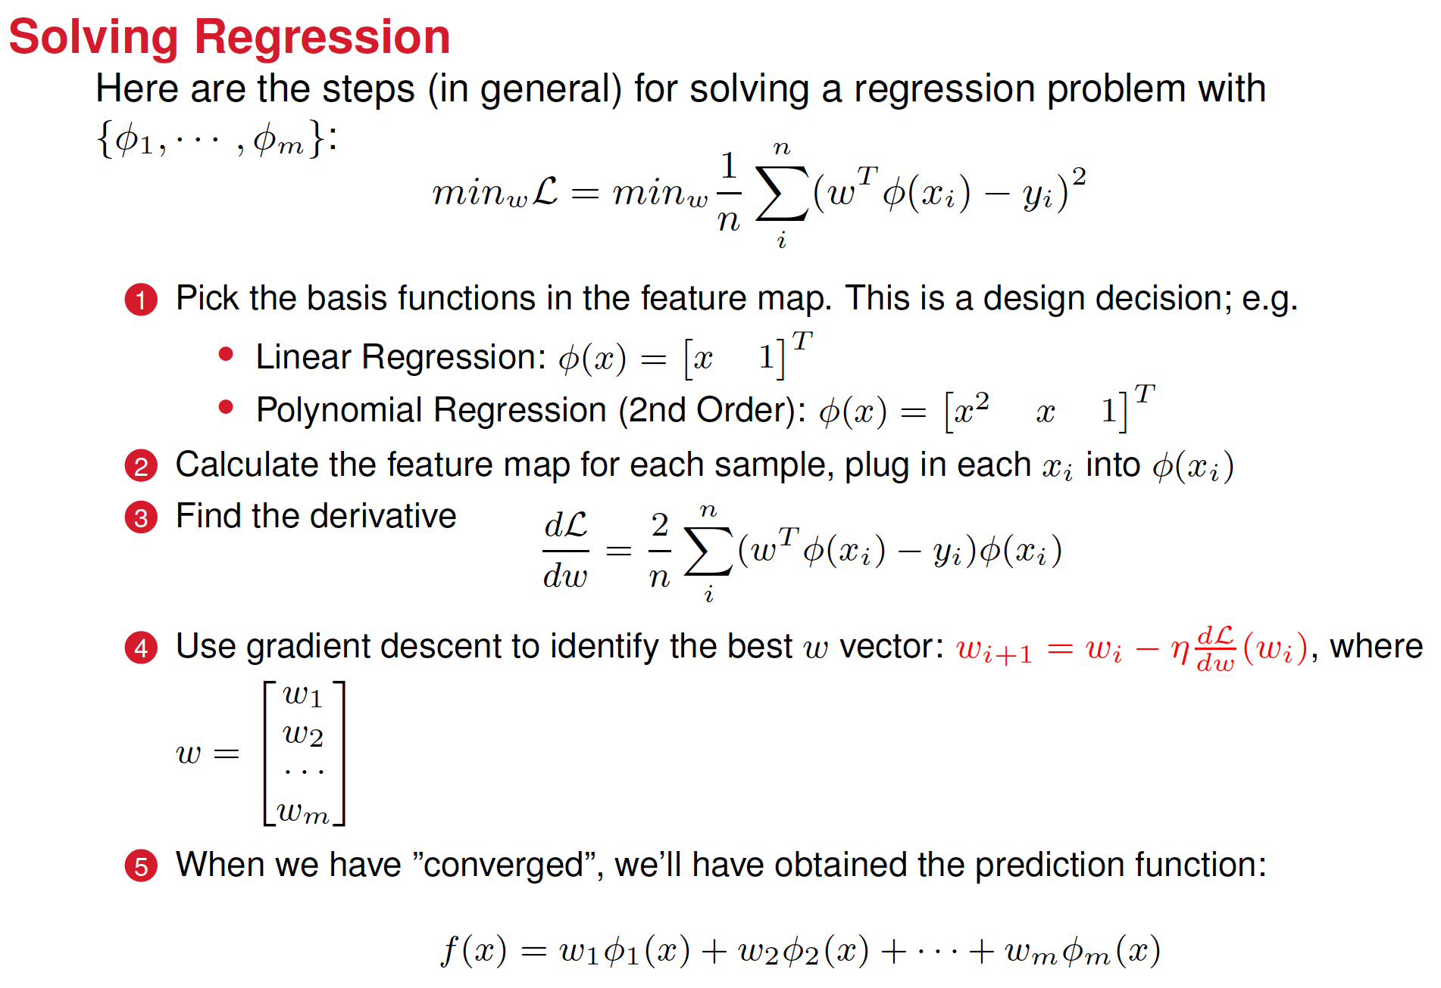
There’s an error here?

Slide 31
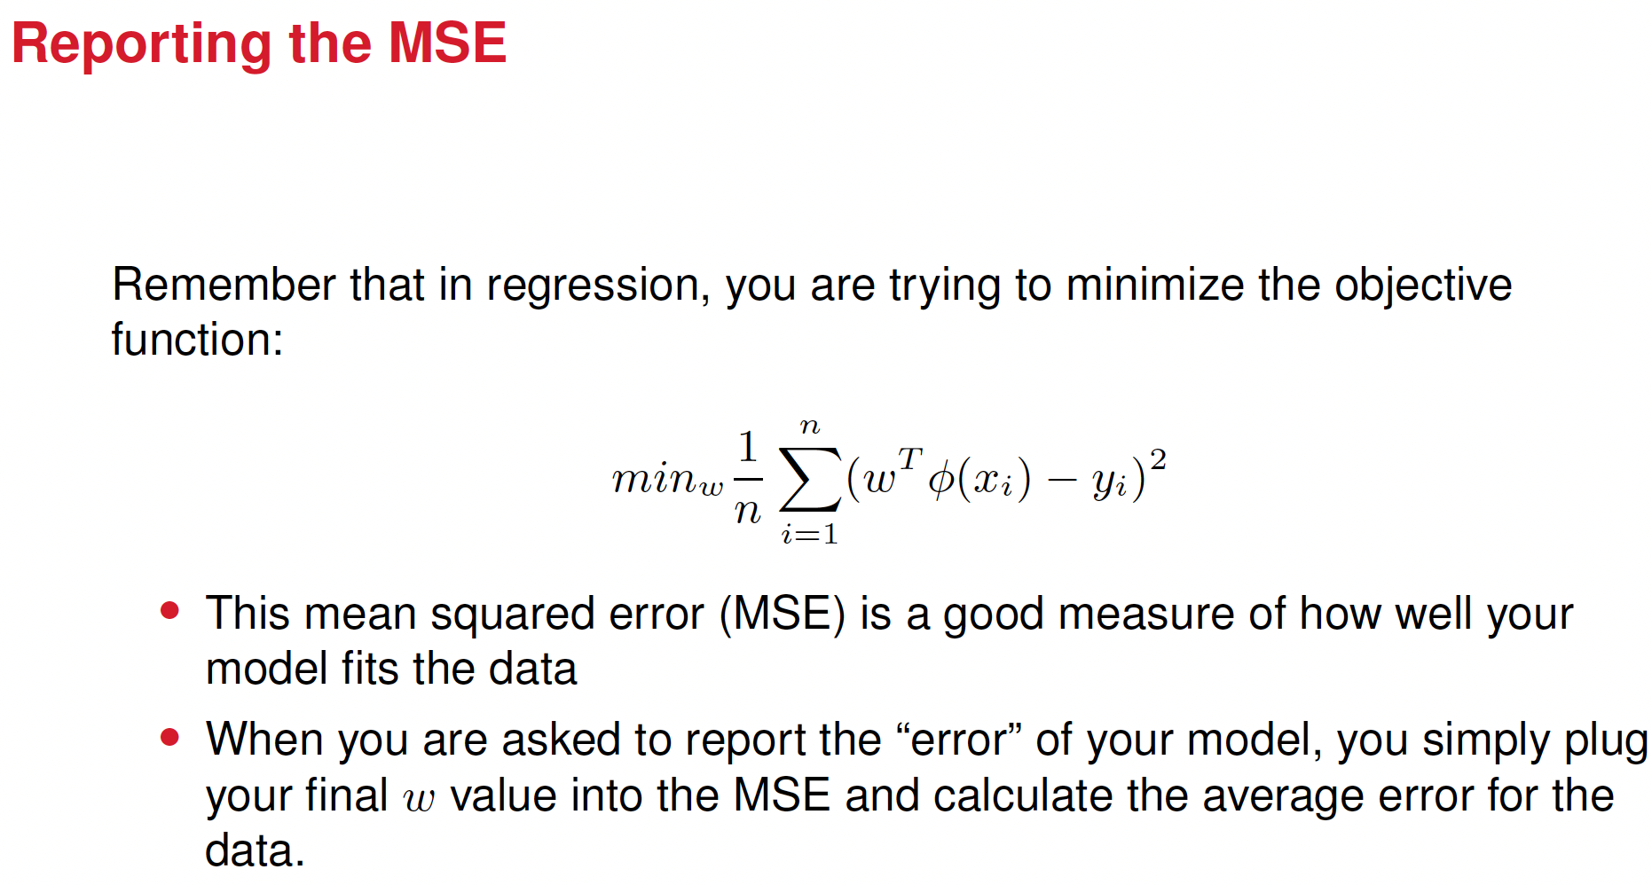

Slide 32
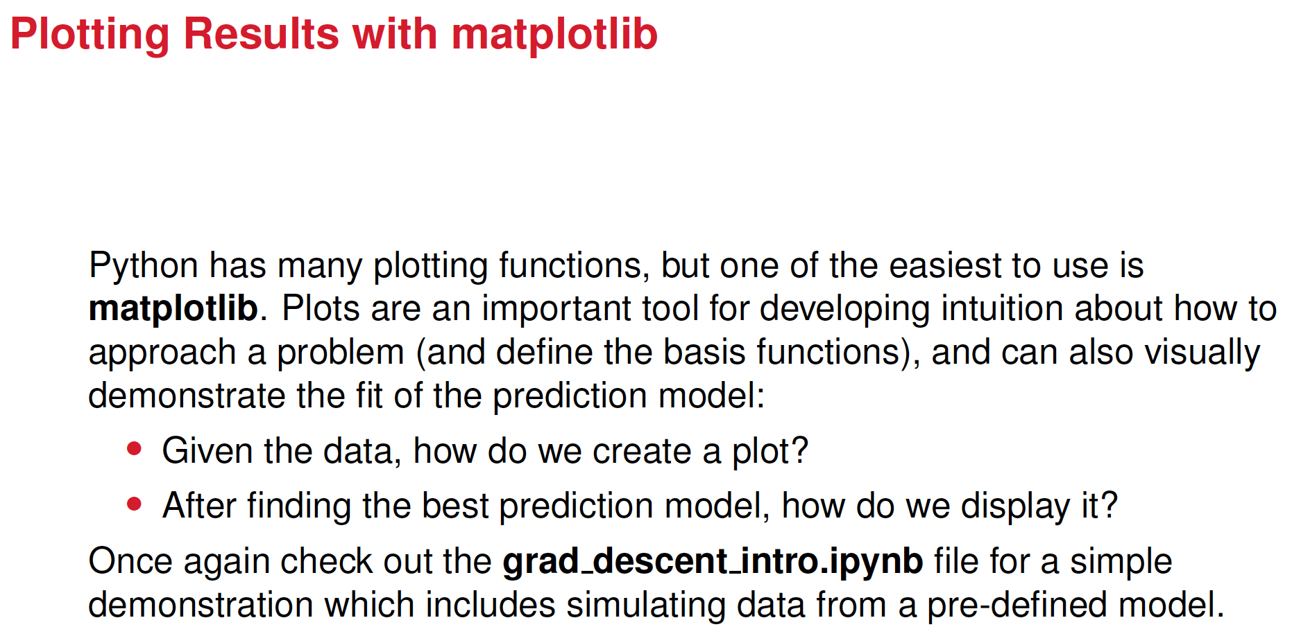


regression_codes.zip

